Slide 1
Protecting Your Personal Information

Slide 2
First Step – lock down your credit.
The three major credit reporting agencies are:
Equifax
Transunion
Experian
Locking your credit means that you can prevent thieves from opening new accounts in your name.
You will have to provide personal information, including your social security number, to verify who you are.
The agencies are no longer allowed to charge you for locking and unlocking your credit.

Slide 3
Equifax Equifax.com/personal/credit-report-services 800-685-1111

Slide 4
Experian experian.com/freeze/center.html 888-EXPERIAN (888-397-3742)

Slide 5
Transunion TransUnion.com/credit-help 888-909-8872

Slide 6
After you have locked your credit
You will be assigned a Pin number or password from each credit agency – print these out and keep these in a safe place. Don’t store them on your computer!
At some point, you might need somebody to be able to check your credit, for example: you are applying for a car loan. You can unlock your credit for either a set period of time or for a particular lender.

Slide 7
Many people are not online – what should they do?
Give this handout to a trusted friend or family member. Remember, to lock your credit they will need to enter your social security number so it must be somebody you can trust. This trusted person can complete the process for you online.
If there is no trusted person, use the provided phone numbers to contact the credit agencies.

Slide 8
Love scams
If you are on social media and are contacted by a stranger who was “drawn to your profile picture,” RUN.
Scammers all over the world pose as amorous suitors. Thousands of Americans have lost millions of dollars.
If you are determined to communicate with this person, at least show the contact to an internet-savvy person in your life. They will be able to run the profile picture and check for giveaways that it’s a scam.
DO NOT give the person your phone number.
Never, ever send money to this person, despite the fact that they claim to: be in the hospital, have to pay fees to leave the country, need a lawyer, were robbed, etc.

Slide 9
Fortune scams
You may be contacted by email or social media with a story about millions of dollars that are stuck in a different country.
Sometimes, the government is holding the money. Sometimes, customs needs to be paid. There may be other “reasons.”
If you will allow the money to go into your bank account, this person will split it with you.
This is a scam. Always.

Slide 10
At the gas station
Thieves may put skimmers on the terminals.
Become familiar with what the entry port for your card looks like at the gas stations you frequent. This will help you spot something unusual looking.
Avoid areas that are low light or areas where staff may not have a clear view.
If in doubt, ask the manager to check for you. Most responsible gas stations check for skimmers once a day.

Slide 11
At the store
Many payment terminals will ask: debit or credit?
Even if you are using a debit card, it probably can be run as credit.
Running a debit as credit will still debit your account as usual, but you will not be asked to enter your PIN number.
The less you enter your PIN number, the better!

Slide 12
Phone scams
Don’t answer unknown calls.
Don’t believe it is the IRS, they only contact you by mail.
Don’t believe it is a young relative calling from jail, or stuck in a foreign country.
Don’t believe it is any official – the police, your municipality or anybody else - who tells you that you are in danger of being arrested.
Don’t believe it is Microsoft wanting to fix your computer
If somebody calls you and asks “Can you hear me?” Hang up the phone.
If a voicemail sounds legitimate, check the phone number before calling back.

Slide 13
Recent phone scams
Demanding gift cards. Nobody, not the IRS, your utility company or anybody else takes payment in gift cards.
Charity. After a disaster, scammers pose as charities. When in doubt, donate to the Red Cross.
Medicare cards. Anybody calling about your Medicare card is a fraudster.
Utility scams. If someone says your water, light or heat will be shut off, hang up and call the utility company.
Social Security number suspended. Your number is never suspended.

Slide 14
By Postal Mail
Fake checks. You are asked to deposit a check, and then send some of the money back.
You’ve won a lottery you never entered. You will be asked to pay some sort of fee.
Work at home scams. You will be asked to buy supplies.
Anything that promises you something for nothing.
Anything that is asking for your personal information.

Slide 15
Stay Alert
The things we have discussed today are not an exhaustive list of the ways and means of becoming an identity theft victim.
Criminals spend all day long thinking up newer and more devious ways to steal money.
Be cautious of people you don’t know.
Verify if an email or phone call has really come from your bank or other vendor – tell them you will call back, and look up the number yourself.
Emails can look very legitimate. If they are asking for information, verify!
To stay up to date on the latest scams, visit: https://www.consumer.ftc.gov/features/scam-alerts

Slide 17
More info on how to protect yourself online
Use anti-virus protection on your computer. If you cannot afford it, use AVAST, a free program. http://download.cnet.com/Avast-Free-Antivirus/3000-2239_4-10019223.html
When downloading programs from the internet, use cnet: https://www.cnet.com/
Learn how to check email addresses by right clicking on name.
Set up bank alerts. Your bank will contact you when something unusual has happened. If you are contacted, verify the number before calling back.
Never click on a link unless you are very sure it is safe
Avoid WiFi
Don’t believe it is your mail server telling you that you have used up all your storage.

Slide 18
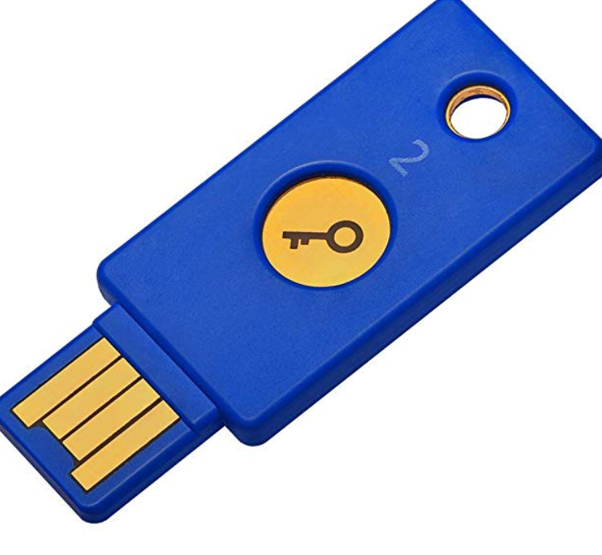
Consider a security key
A security key can be enabled if you use a chrome browser.
It is a physical key that fits into your usb port.
You link the key to your account using Google’s 2 step authentication process.
Even if a thief steals your password, they cannot get into your account without the key.
Note – if you use another computer, you won’t be able to get into your accounts either without the key. Most vendors recommend purchasing 2 keys, in case one is lost.

Slide 19
RFID wallets
Credit and Debit cards may come with a radio frequency ID (RFID) chip. A thief with an RFID reader could gain access to your card right through your purse.
RFID wallets block RFID readers.
There is a debate about whether the risk is high enough to warrant buying an RFID wallet, however, they can be purchased for less than ten dollars.
Whether you choose an RFID or not, remember – Locking your credit does not stop thieves from stealing credit card numbers you already have.

